Slide 1
2024-25 NFHS Wrestling Rules interpretation PowerPoint
B. Elliot Hopkins, MLD, CAA, NFHS Director of Sports, Sanctioning and Student Services

Slide 2
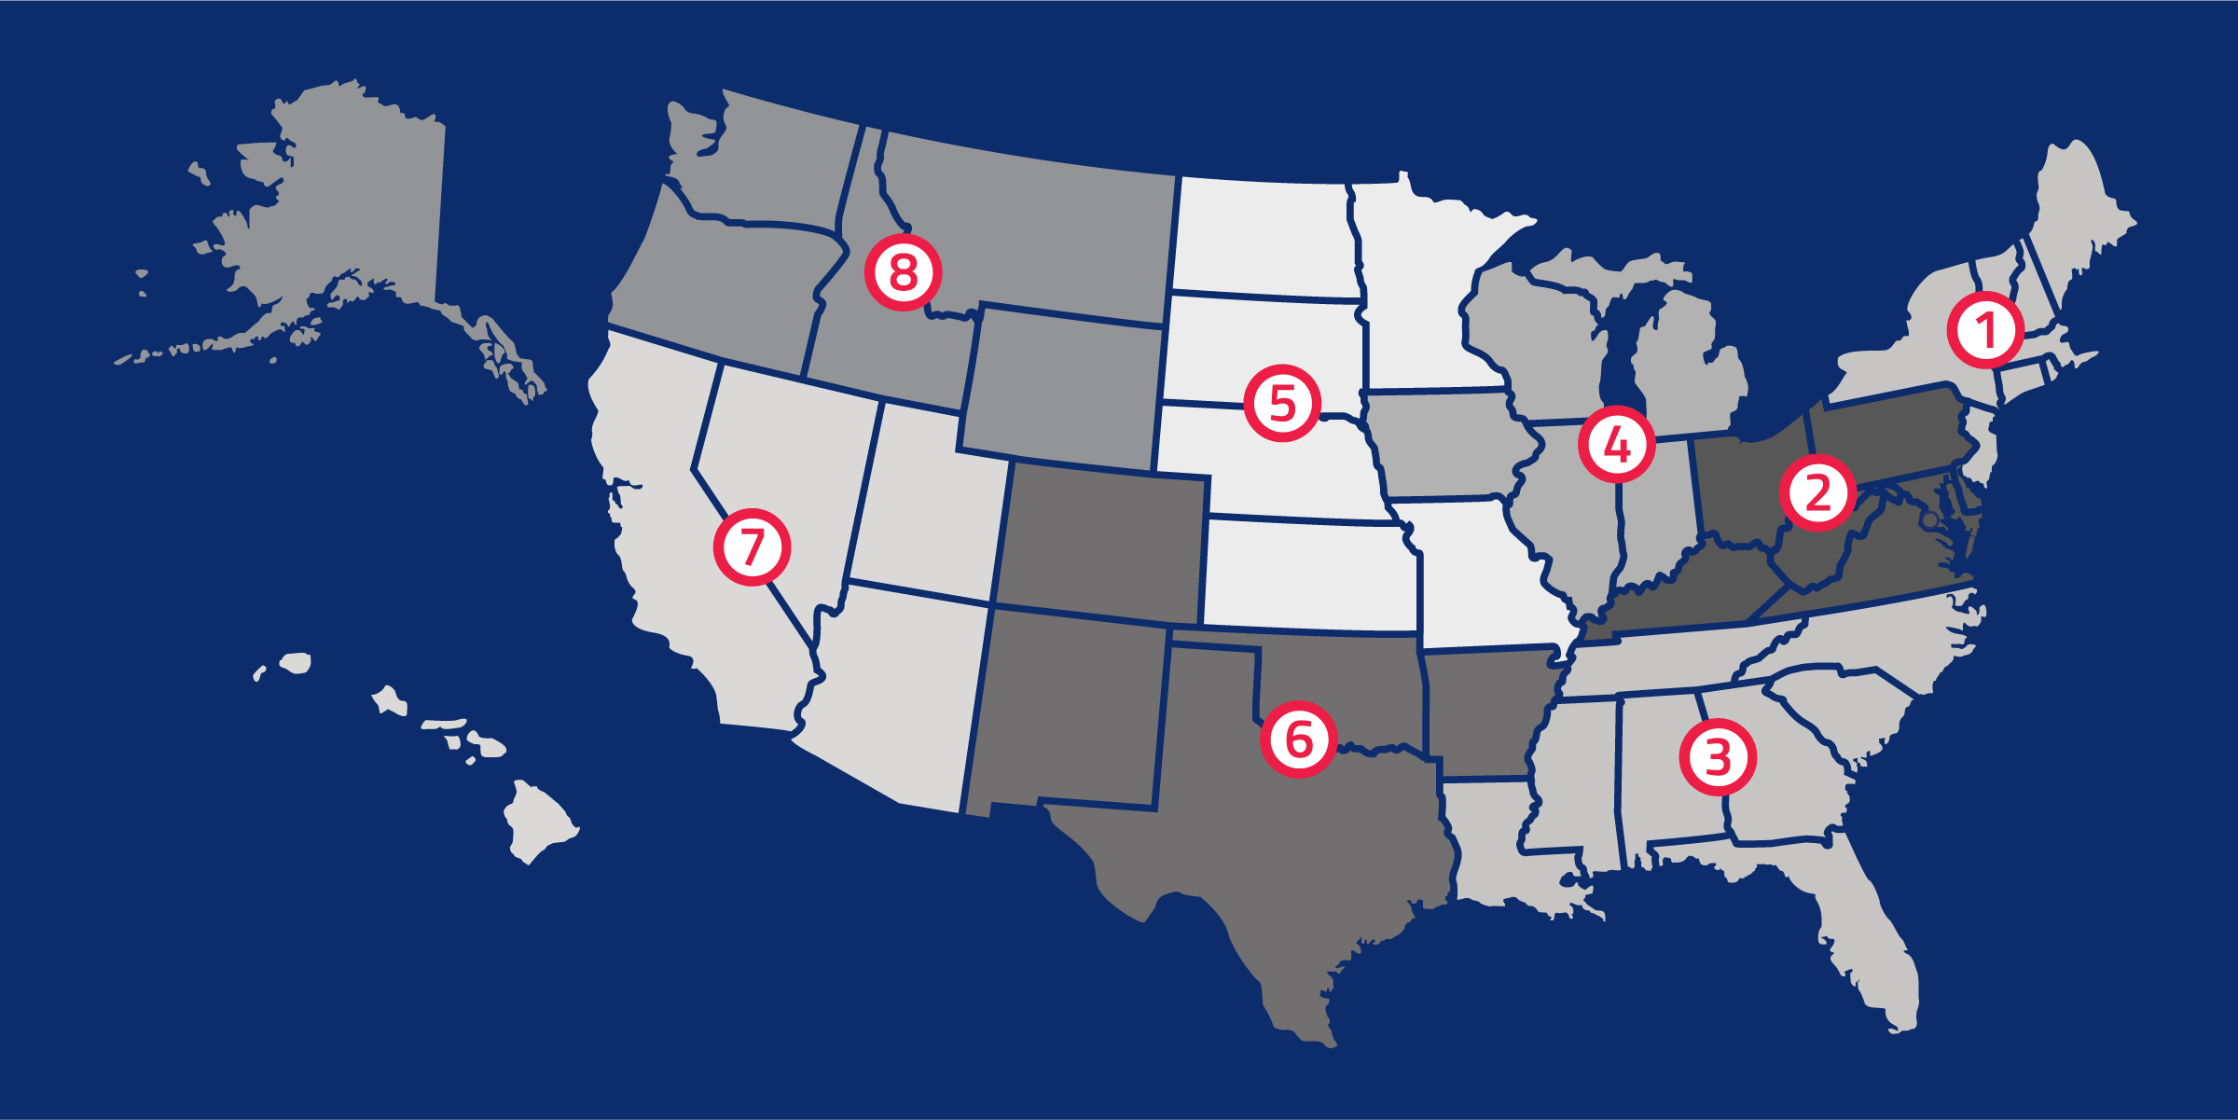
National Federation of State High School Associations
NFHS (located in Indianapolis, IN – Est. 1920):
National leader and advocate for high school athletics and performing arts programs.
Serves 51 state associations, 19,500 high schools and 12 million student participants.
Writes playing rules for 17 high school sports for boys and girls.
Offers online education courses for high school coaches, officials, parents, students and others.
Ensures that students have opportunity to enjoy healthy participation, achievement and good sportsmanship in education-based athletics.

Slide 3
NFHS Rules Review Committee
The NFHS Rules Review Committee is chaired by the chief operating officer and composed of all rules editors. After each committee concludes its deliberations and has adopted its recommended changes for the subsequent year, such revisions will be evaluated by the Rules Review Committee.
Davis Whitfield
Chief Operating Officer
Lindsey Atkinson
Basketball, Girls Lacrosse and Volleyball
Bob Colgate
Football and Sports
Medicine
Sandy Searcy
Softball, Swimming & Diving and Water Polo
Elliot Hopkins
Baseball and Wrestling
Julie Cochran
Cross Country, Gymnastics, Field Hockey, Soccer and
Track & Field
James Weaver
Boys Lacrosse
and Spirit
Dan Schuster
Ice Hockey

Slide 4
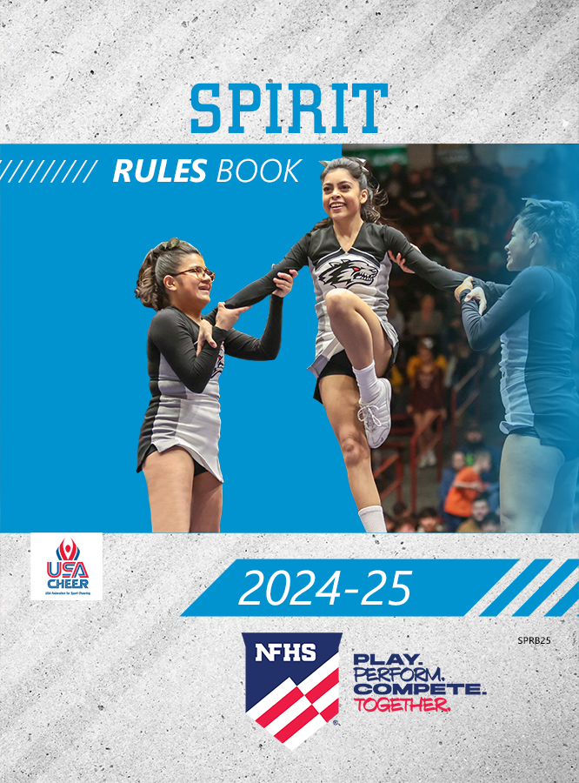
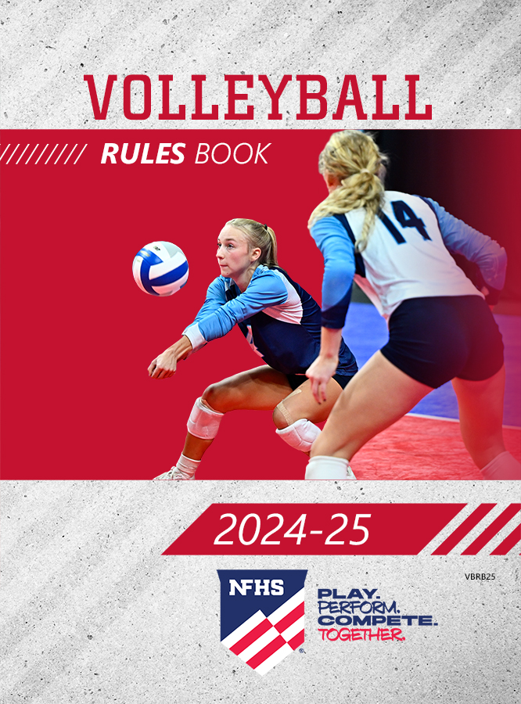
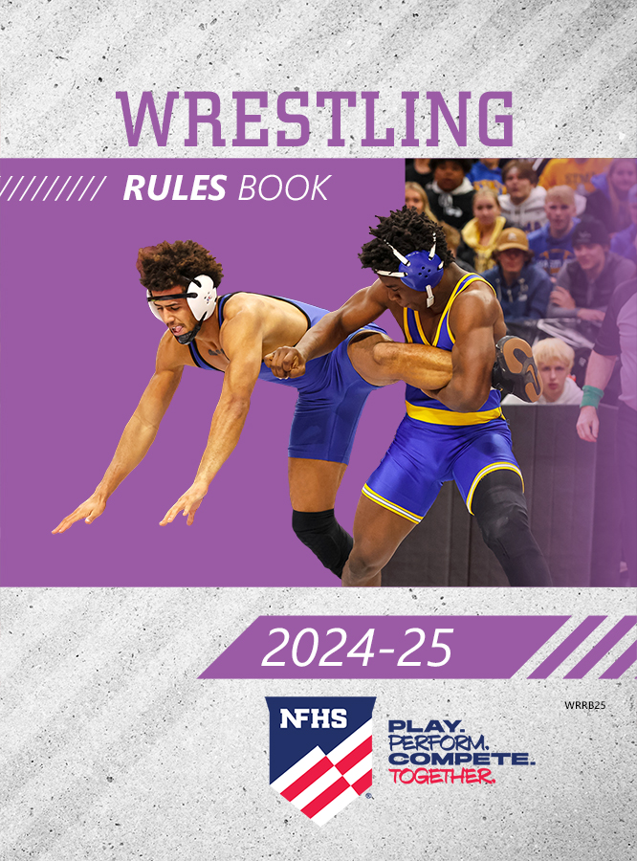
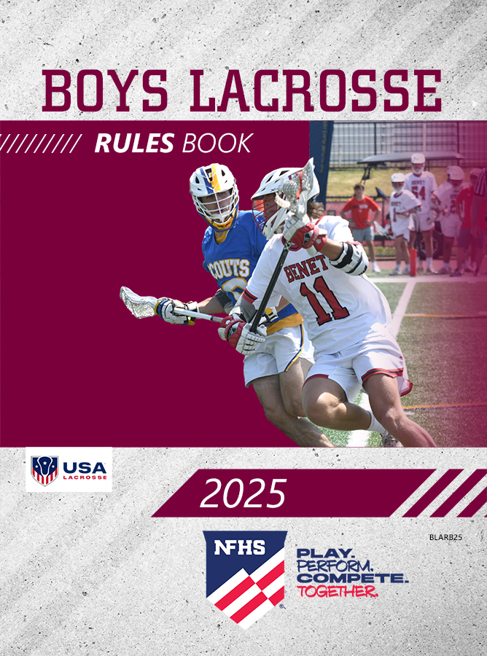
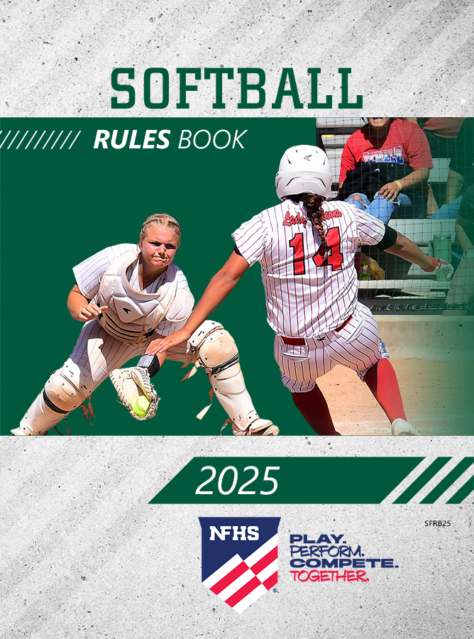
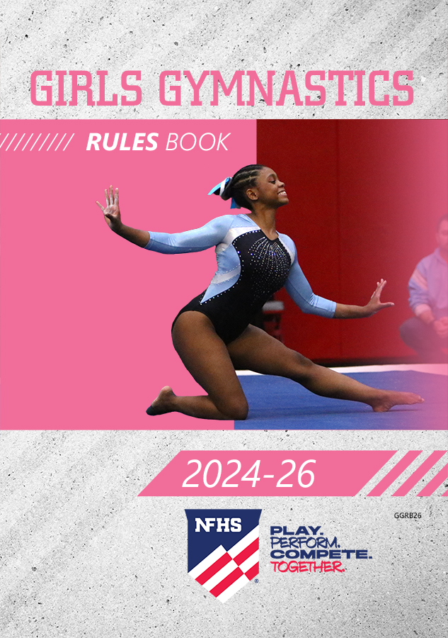
NFHS Publications
The NFHS writes playing rules for 17 sports for boys and girls at the high school level.
Publishes 4 million pieces of materials annually.

Slide 5
Wrestling rule changes

Slide 6
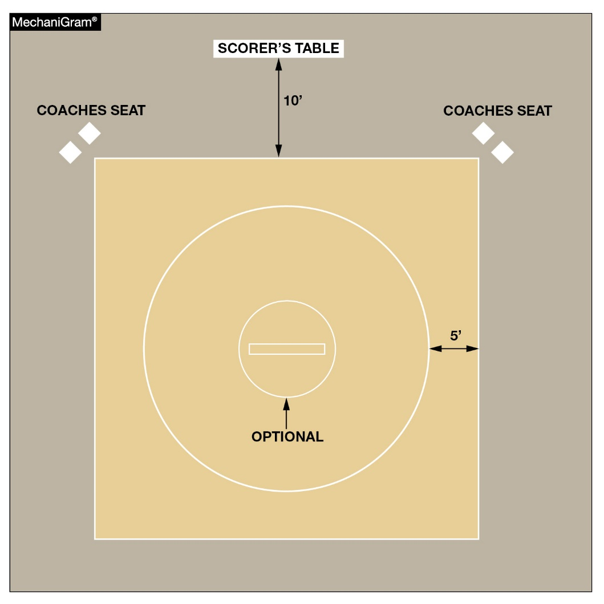
Rule 2-1-3 mat
The 10-foot circle at the center of the mat is now optional.

Slide 7
Optional 10’ circle rule 2-1-3
ART. 3 . . . The wrestling area shall be marked on the mat by painted lines, 2 inches wide, which are inbounds. At the center of the mat there shall be may be a an optional 10-foot circle, indicated by a 2-inch line. When the area enclosed by the optional 10-foot circle and the inbounds area of the mat are of contrasting colors, the 2-inch line may be omitted.
Rationale:
The starting lines of a mat indicate the center of the mat and the 10-foot circle is not needed. With the new mat designs that have a large mascot or logos, it gives a refreshing look to the wrestling mats. Wrestlers and officials know where the center of the mat is located without the 10-foot circle being present.

Slide 8
Optional 10’ circle rule 2-1-4
ART. 4 . . . Starting lines, 1 inch wide, shall be placed at the center of the mat and the front line should lie on the diameter of the optional 10-foot circle or the diameter of the circle that encloses the wrestling area. These 1-inch starting lines shall be parallel, 3-feet long, and 12 inches from outside to outside. The two 3-foot lines shall be connected on one end by a 1-inch red line and on the other end by a 1-inch green line.
Rationale:
Same.

Slide 9
Optional 10’ circle rule 5-24-1
ART. 1 . . . Each wrestler is required to make an honest attempt to stay within the 10-foot circle in the center of the mat and wrestle aggressively, regardless of position or the time or score of the match. Action is to be maintained throughout the match by the contestants wrestling aggressively whether in the top, bottom or neutral position and both contestants are equally responsible for initiating action.
Rationale:
Same.

Slide 10
Optional 10’ circle rule 6-5-1
ART. 1 . . . If no fall occurs during the final period, the referee shall direct the wrestlers to return and remain on the 10-foot circle in the center of the mat while the referee verifies the match score. (It may be necessary for the referee to go to the scorer’s table.)
Rationale:
Same.

Slide 11
Optional 10’ circle rule 6-6-6
ART. 6 . . . When a coach believes the referee has misapplied a rule or disagrees with judgment, the coach may approach the scorer’s table, request the match be stopped (when there is no significant action) and discuss the matter with the referee directly in front of the scorer’s table. Both wrestlers shall return and remain on the 10-foot circle in the center of the mat. If the referee has misapplied a rule, necessary adjustments will be made, an explanation to the opposing coach will be made, and wrestling will immediately be resumed.

Slide 12
Optional 10’ circle rule 6-6-6 (cont.)
If there is no error, or if the coach disagrees with the referee’s judgment, the coaching staff will be penalized for coach misconduct. The first time it occurs in a dual meet or a tournament is a warning; the second time is the deduction of 1 team point; and the third time the head coach shall be removed from the premises for the remainder of the day and 2 team points deducted.
Rationale:
Same.

Slide 13
Optional 10’ circle rule 7-6-1
ART. 1 . . . Each wrestler is required to make an honest attempt to stay within the 10-foot circle in the center of the mat and wrestle aggressively, regardless of position or the time or score of the match. Action is to be maintained throughout the match by the contestants wrestling aggressively whether in the top, bottom or neutral position and both contestants are equally responsible for initiating action.

Slide 14
Optional 10’ circle rule 7-6-1 (cont.)
It is the responsibility of contestants, coaches and referees to avoid the use of stalling tactics or allowing the use thereof. This shall be demonstrated by those responsible with strict enforcement by referees.
Rationale:
Same.

Slide 15
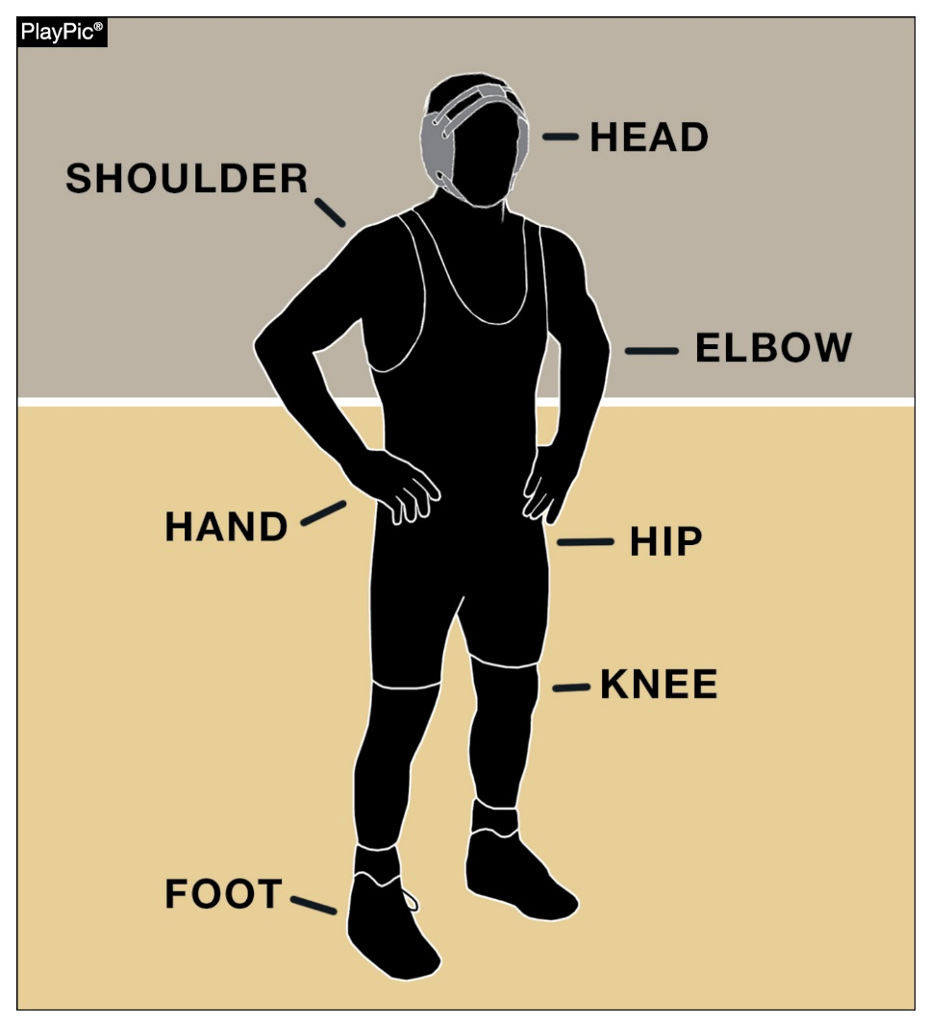
Points of contact rules 5-10, 5-15-1, 5-15-2c, 5-15-3, 5-18, 5-22-1, 5-22-2, 5-25-1, 5-25-3, 6-4-1
Only one point of contact must be inbounds (inside or on the boundary lines) in order for wrestling to continue. Points of contact include the head, shoulder, elbow, hand, hip, knee and foot.

Slide 16
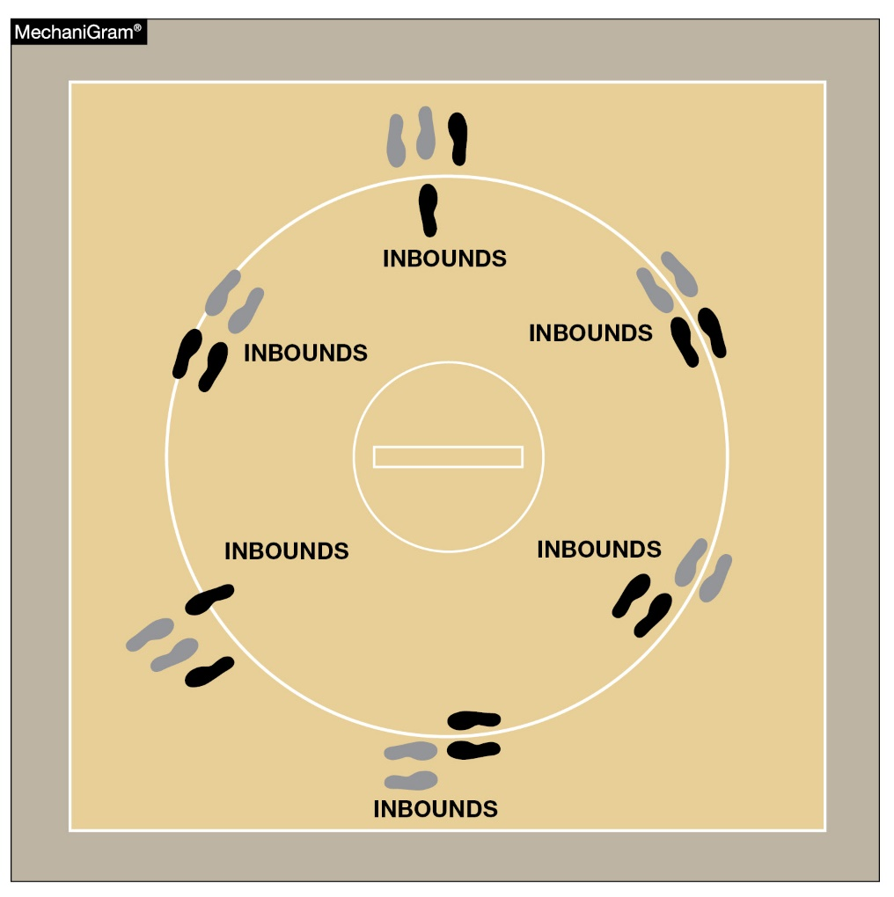
Points of contact rules 5-10, 5-15-1, 5-15-2c, 5-15-3, 5-18, 5-22-1, 5-22-2, 5-25-1, 5-25-3, 6-4-1
Only one point of contact must be inbounds in order for wrestling to continue.

Slide 17
One point of contact rule 5-10
ART. 10 . . . An escape is when the defensive wrestler gains a neutral position and the opponent has lost control, beyond reaction time, while one a total of two supporting points point of contact of either wrestler is are inbounds. The total of two supporting points could be two supporting points of one wrestler or one supporting point of each wrestler. If there is no action at the edge of the mat, the referee shall stop the match.

Slide 18
One point of contact rule 5-10 (cont.)
Rationale:
This rule would safely eliminate the subjectivity of the out of bounds call. The rule change would also help coaches and wrestlers understand more clearly what out of bounds is and help officials call out of bounds more consistently.

Slide 19
One point of contact rule 5-15-1
ART. 1 . . . Contestants are considered to be inbounds if one a total of two point of contact of either wrestler is inside or on the boundary lines. The total of two supporting points could be two supporting points of one wrestler or one supporting point of each wrestler that are inside or on the boundary lines. (Photo 11)
Rationale:
Same.

Slide 20
One point of contact rule 5-15-2b
ART. 2 . . . b. When the defensive wrestler is on their back while the supporting point of contact of either wrestler are inbounds wrestling shall continue. In this situation any part of a defensive wrestler's shoulder or scapula is can be considered to be all the point(s) of contact, as well as other point(s) of contact mentioned in 5.15.2a.
Rationale:
Same.

Slide 21
One point of contact rule 5-15-2c
ART. 2 . . . c. Near-fall points or fall shall be earned only while a the supporting point of contact of either wrestler is are inbounds. In a pinning situation, when all parts of the defensive wrestler's shoulders/scapula are on the mat beyond the boundary line, if the feet including toes and heels of the offensive wrestler are the supporting points, the offensive wrestler's knee(s) must be inside the boundary, whether in contact with or above the mat.
Rationale:
Same.

Slide 22
One point of contact rule 5-15-3
ART. 3 . . . Wrestling shall continue as long as one a total of two supporting point of contact of either wrestler is inside or on the boundary lines. The total of two supporting points could be two supporting points of one wrestler or one supporting point of each wrestler that remain inbounds. If there is no action at the edge of the mat, the referee shall stop the match.
Rationale:
Same.

Slide 23
One point of contact rule 5-18
Section 18 . . . Out of bounds occurs when there are is no longer two total supporting points of contact of either wrestler inside or on the boundary line. The total of two supporting points could be two supporting points of one wrestler or one supporting point of each wrestler inside or on the boundary line.
Rationale:
Same.

Slide 24
One point of contact Rule 5-22-1
ART. 1 . . . It is a reversal when the defensive wrestler comes from underneath and gains control of the opponent, either on the mat or in a rear-standing position, while one the total of two supporting points are of contact is inside or on the boundary line. Two supporting points could be two supporting points of one wrestler or one supporting point of each wrestler. If there is no action at the edge of the mat, the referee shall stop the match. (Photos 21 & 22)
Rationale:
Same.

Slide 25
One point of contact rule 5-22-2
ART. 2 . . . In awarding a reversal at the edge of the mat, control must be established while one the total of two supporting points of contact of each either wrestler is inside or on the boundary line. The total of two supporting points could be two supporting points of one wrestler or one supporting point of each wrestler inside or on the boundary line or while at least the feet/ foot of the scoring contestant finish down on the mat inbounds.
Rationale:
Same.

Slide 26
One point of contact rule 5-25-1
ART. 1 . . . It is a takedown when, from the neutral position, a wrestler gains control over the opponent down on the mat and one a total of two supporting points of contact of either wrestler are is inbounds. The total of two supporting points could be two supporting points of one wrestler or one supporting point of each wrestler that are inbounds. When the defensive wrestler's hand(s) touch the mat, it is considered a supporting point(s). (Photos 23-30)
Rationale:
Same.

Slide 27
One point of contact rule 5-25-3
ART. 3 . . . In awarding a takedown at the edge of the mat, control must be established while one a total of two supporting points of contact of either wrestler are is in bounds. The total of two supporting points could be two supporting points of one wrestler or one supporting point of each wrestler that are inbounds or while at least the feet foot of the scoring contestant finish down on the mat inbounds. (Photos 32-34)
Rationale:
Same.

Slide 28
One point of contact rule 6-4-1
ART. 1 . . . When there are is no longer a total of two supporting point of contact points of either wrestler on or inside the boundary line, wrestling shall be stopped and wrestlers returned to the center of the mat and started according to the position of each at the time they went out of bounds. The total of two supporting points could be two supporting points of one wrestler or one supporting point of each wrestler inside or on the boundary line.

Slide 29
One point of contact rule 6-4-1 (cont.)
If the wrestlers go out of bounds in the neutral position, the match shall be resumed with each wrestler at the designated green or red area. If the fourth stalling penalty is awarded, the match is stopped and the opponent gets choice on restart.
Rationale:
Same.

Slide 30
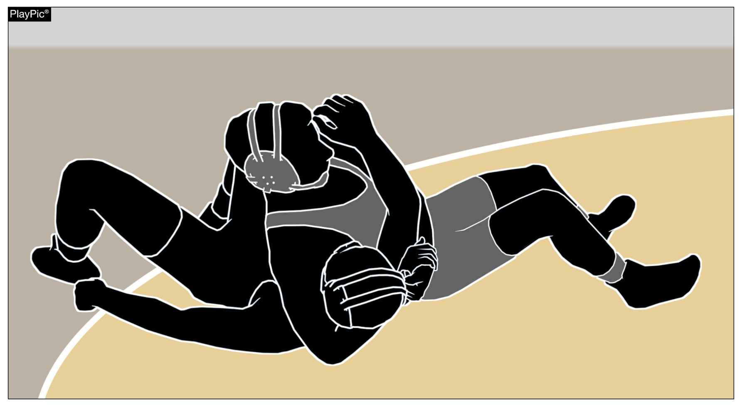
Near-fall rules 5-11-2g, 5-11-2h, 5-11-3, 9-1-5
Depending on how long criteria is met, a wrestler may score two, three, four or five points for a near-fall.

Slide 31
Near-fall rule 5-11-2g, h
ART. 2 . . . A near fall occurs when the offensive wrestler has control of the opponent in a pinning situation and near-fall criteria are met for a period of two seconds or longer. (Photos 5-8):
Sub-articles a-f, i remain the same.
g. If the defensive wrestler is injured, indicates an injury or bleeding occurs after the two-point near-fall criteria of two count have been met and before the three-point near-fall criteria of a three count have been earned, the match will be stopped, and a three-point near-fall will be awarded. If near-fall criteria of three count have been met and before the four-point near-fall criteria of a four count have been earned, the match will be stopped, and a four-point near-fall will be awarded.
h. If the defensive wrestler is injured or indicates and injury or bleeding occurs after a four-point near fall is earned, the match will be stopped, and a five-point near fall shall be awarded;

Slide 32
Near-fall rule 5-11-2g,h (cont.)
Rationale: The goal in wrestling is to pin your opponent. Changing the near-fall points awarded should motivate wrestlers to work for a fall and simplify the points award based on how long the wrestler is held in near-fall criteria.

Slide 33
Near-fall rule 5-11-3
ART. 3 . . . If the near-fall criteria are met for a period of two seconds, a two-point near fall will be earned and if the near-fall criteria are met for five continuous seconds, a three-point near fall will be earned. If the near-fall criteria are met for two continuous seconds a two-point near-fall will be earned. If near-fall criteria are met for three continuous seconds a three-point near-fall will be earned. If near-fall criteria are met for four continuous seconds a four-point near-fall will be earned.
Rationale:
Same.

Slide 34
Near-fall rule 9-1-5
ART. 5 . . . The wrestler in the advantage position is awarded two-points when near-fall criteria is met for two seconds or if the defensive wrestler is injured, indicates an injury or bleeding occurs just prior to near-fall criteria of two seconds is met. Three-points will be awarded when near-fall criteria is met for three seconds or if the defensive wrestler is injured, indicates an injury or bleeding occurs after two-point near-fall has been earned just prior to near-fall criteria of three seconds is met.

Slide 35
Near-fall rule 9-1-5 (cont.)
Four-points will be awarded when near-fall criteria is met for four seconds or if the defensive wrestler is injured, indicates an injury or bleeding occurs after the three-point near fall has been earned just prior to near-fall of four seconds is met. Five points will be awarded if the defensive wrestler is injured, indicates an injury or bleeding occurs after the four-point near-fall has been earned. A visual hand count, to determine the time, shall be used when feasible.
Rationale:
Same.

Slide 36
Near-fall scoring symbols
All symbols remain the same except the following:
N₂ Near-Fall 2 seconds
N₃ Near-fall 3 seconds
N₄ Near-fall 4 seconds
N₅ Near-fall (as a result of injury, indication of injury or bleeding occurs after four-points near-fall has been earned)
Rationale:
Same.

Slide 37
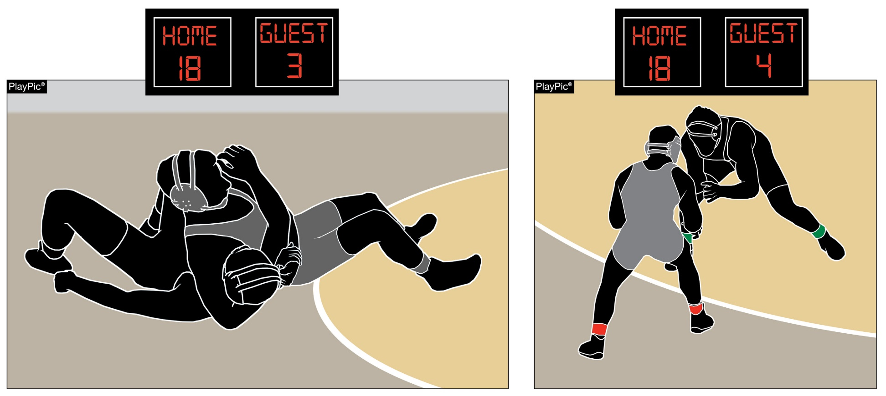
Technical fall rule 5-11-4
A
B
In PlayPic A, the offensive wrestler has met near-fall criteria to take a 15-point lead. When the criteria is no longer met, as in PlayPic B, the match ends with a technical fall.

Slide 38
Technical fall rule 5-11-4
ART. 4 . . . A technical fall occurs when a wrestler has earned a 15-point advantage over the opponent, however;
If a takedown or reversal, straight to a near-fall criteria creates a 15-point advantage, the match shall continue until the near-fall situation criteria has concluded is no longer met. Conclusion of the near-fall criteria is immediate.
Remains the same.

Slide 39
Technical fall rule 5-11-4
Rationale:
This change will consistently clarify when the technical fall has concluded in relation to the near-fall criteria being met. The offensive wrestler cannot be penalized appropriately after the technical fall has been earned.

Slide 40
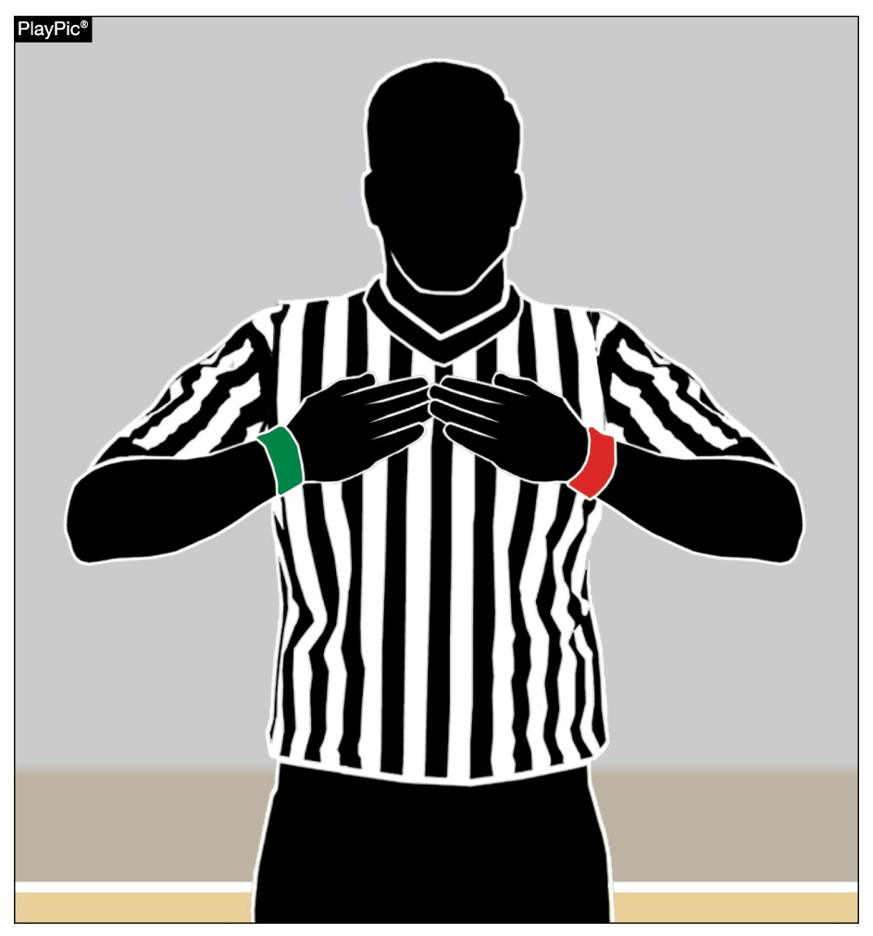
Signal chart
A signal has been added to the signal chart. Tapping the chest with hands flattened indicates a referee’s time-out.

Slide 41
Time-out signal
ART. 4 . . . Referee's time-out. If the referee needs to address a situation not covered by injury, blood or recovery time, a referee's time-out shall be charged. That signal would be both hands/fingers pointing inward to the referee’s chest.
Rationale:
This signal is used universally in many other sports but has never been codified in the NFHS Wrestling Rules Book. An additional signal needs to be added to the Official Wrestling Signal making it signal #29.

Slide 42
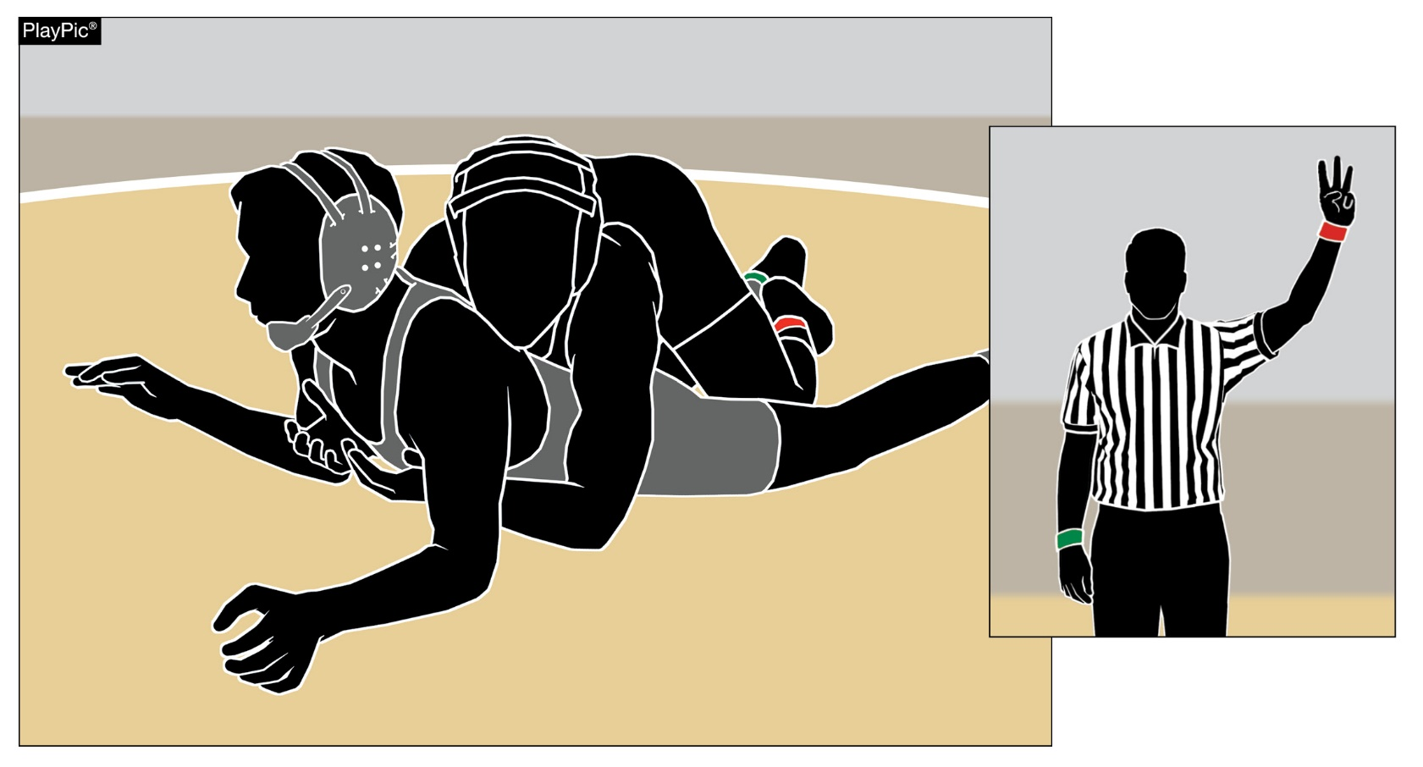
Takedown rule 9-1-2, summary of scoring
When a takedown is secured, the wrestler shall be awarded three points.

Slide 43
Takedown rule 9-1-2
ART. 2 . . . When a takedown is secured, the wrestler shall be awarded two three match points.
Rationale:
To promote more scoring activity when wrestlers are in neutral position.

Slide 44
Takedown summary of scoring & scoring symbols
SUMMARY OF SCORING
Note: Everything remains the same except:
Takedown 3pts.
SCORING SYMBOLS
Note: Everything remains the same except:
T2 T₃. . . . . . . . . Takedown
Rationale:
This is a complimentary rule change to reflect the action taken with Rule 9-1-2.

Slide 45
Points of emphasis

Slide 46
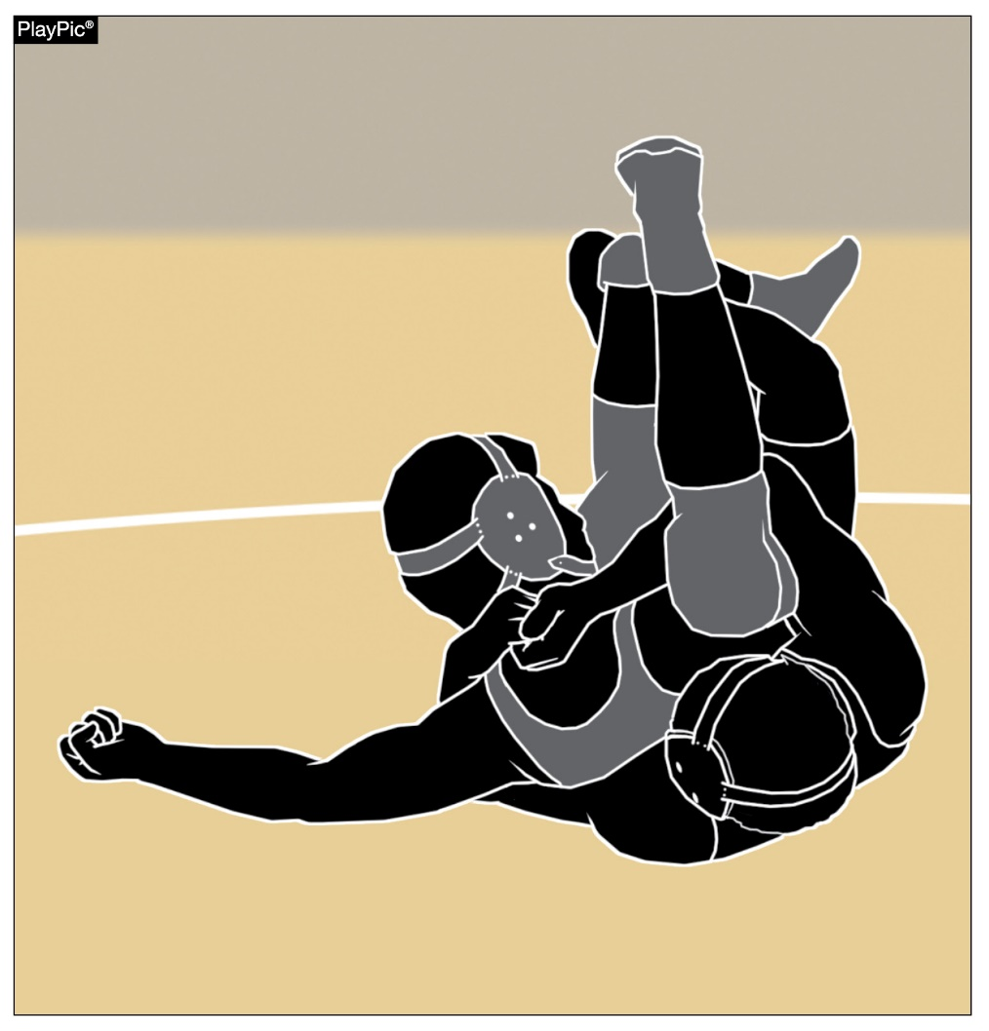
Dangerous maneuvers and holds
Coaches and referees must work together to keep certain techniques out of wrestling. Illegal holds as the nelson cradle shown here must be eradicated from the sport. The NFHS abhors any move, maneuver or hold that intentionally injures limbs, joints, penetrates any body cavities or renders a wrestler unconscious.

Slide 47
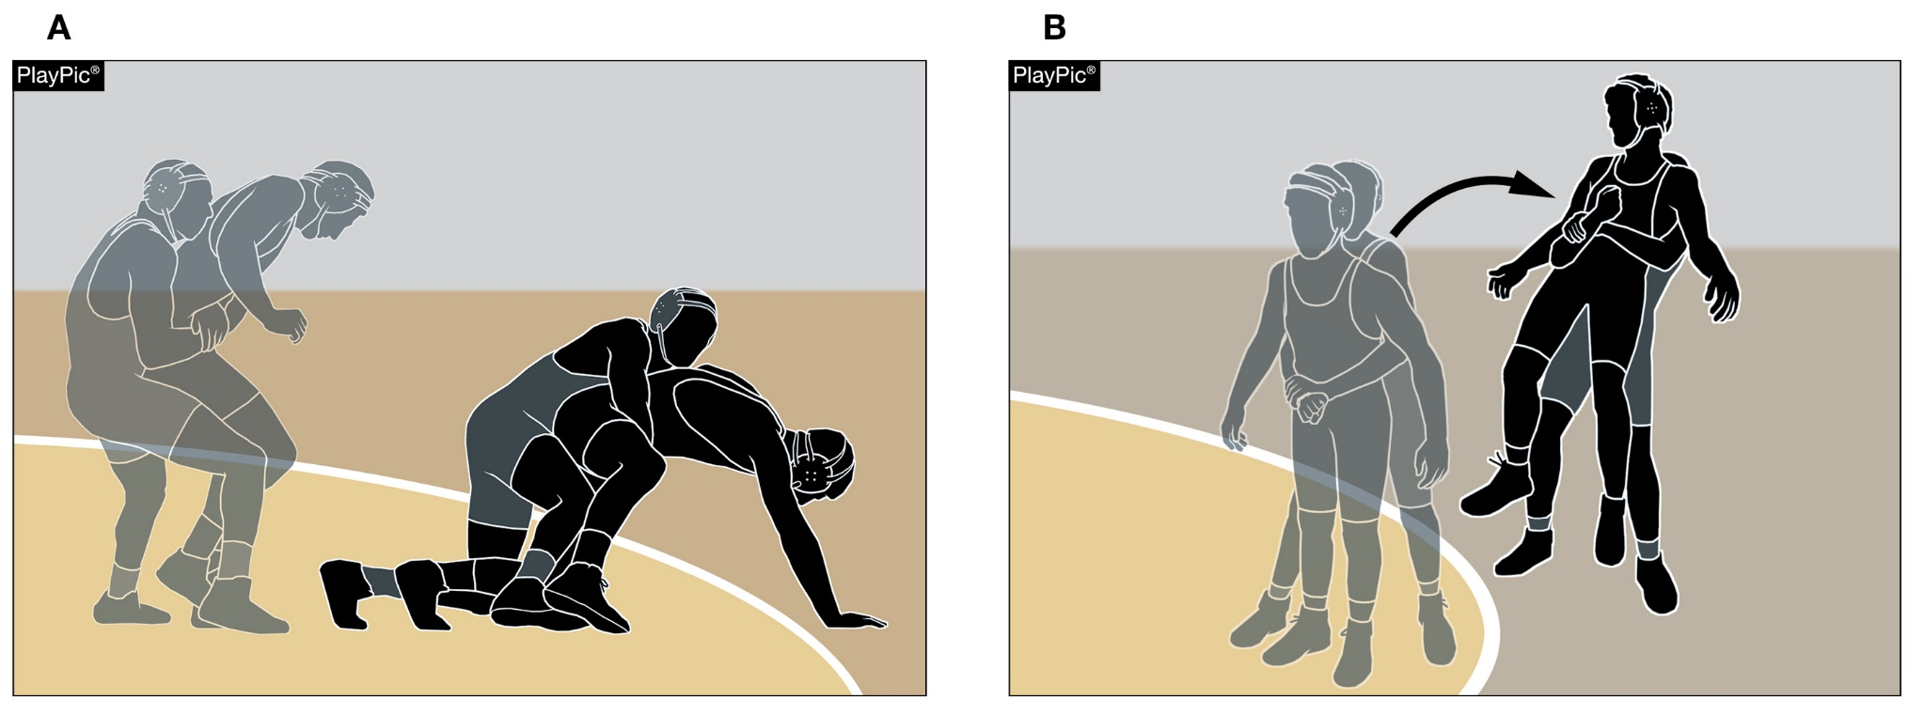
Stalling
Defensive wrestler not wrestling aggressively (A) and pulling the wrestler out of bounds from behind (B) are acts of stalling. Penalizing stalling helps ensure an exciting, competitive match.

Slide 48
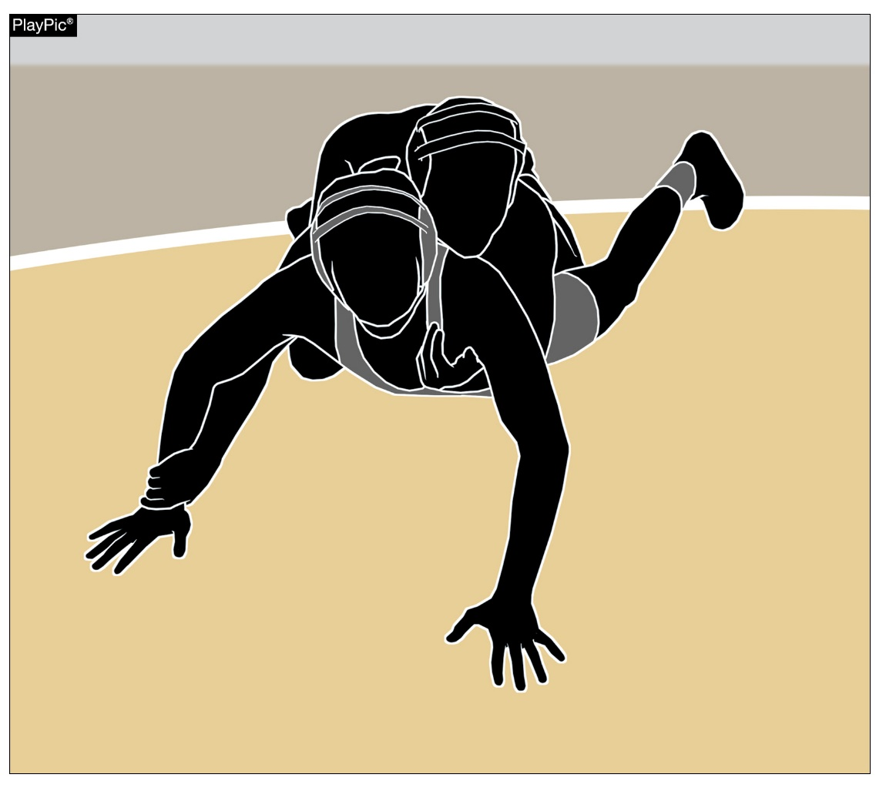
STALEMATE
A stalemate occurs when neither wrestler can improve their respective positions.

Slide 49
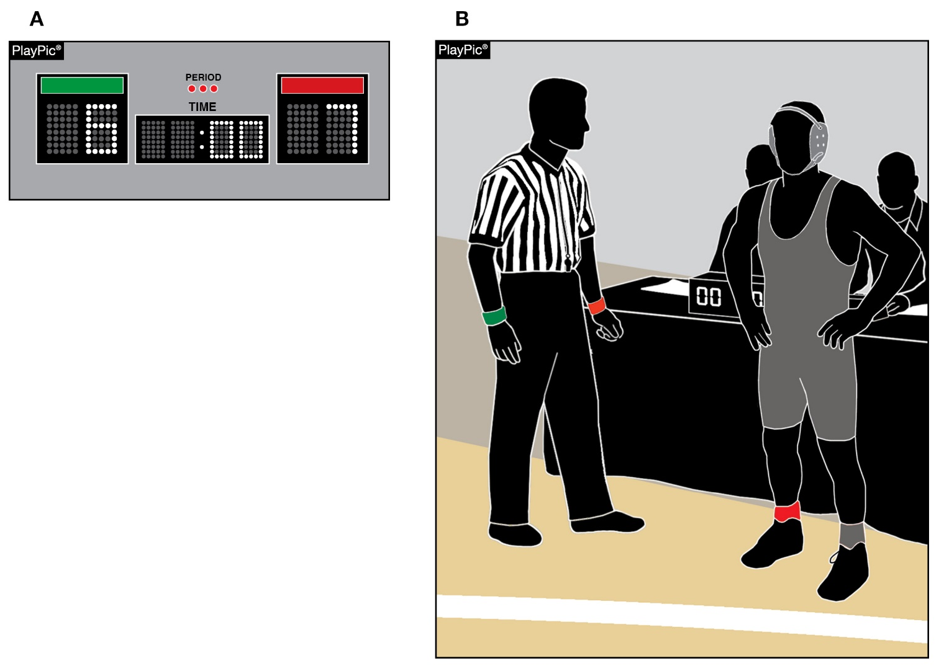
Referee’s duties
The referee works with meet personnel to ensure the score is correct and the proper wrestler has secured the victory. Other duties include skin checks and grooming, checking the legality of special equipment, uniforms, pads and taping, the referee is responsible for making sure the mat, mat areas and their markings are compliant.

Slide 50
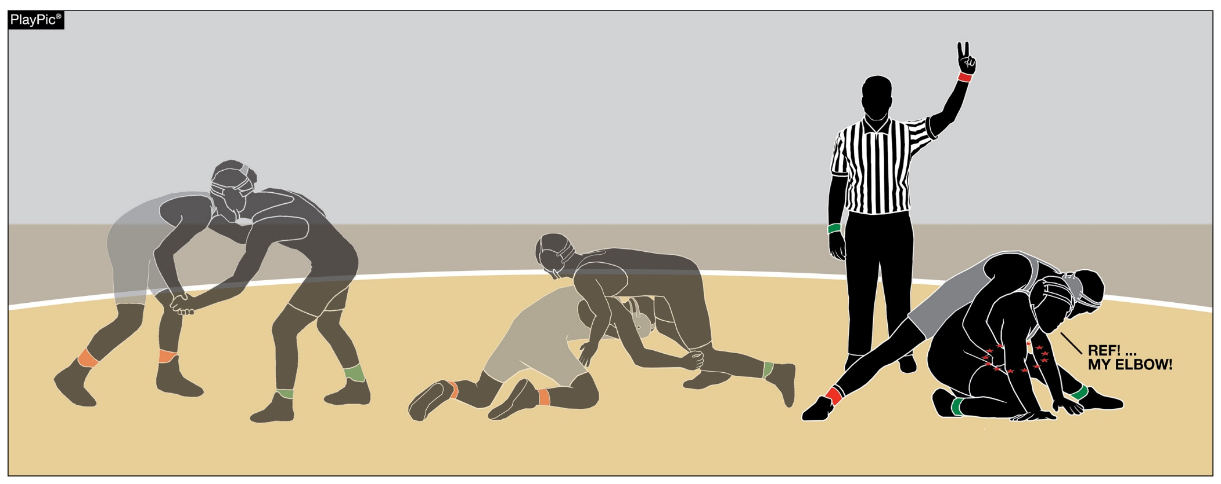
IMMINENT SCORING
Imminent scoring is typically referred to as a situation where one wrestler is on the verge of scoring point(s).

Slide 51
Default, forfeit, medical forfeit
• A default is awarded when a wrestler is unable to continue wrestling for any reason. The opponent wins and the defaulting wrestler receives the loss.
• A forfeit is when an opponent fails to appear for a match for any reason. Their opponent shall be present in a legal uniform on the mat, ready to wrestle. The forfeiting wrestler takes a loss on their record and is out of competition.
• It is a medical forfeit if the forfeiting wrestler cannot wrestle due to an injury or illness that occurred during the tournament. The wrestler remains in the tournament if possible (moving down to the consolation bracket) and does not take a loss on their record.

Slide 52
Nfhs Allaccess

Slide 53
NFHS AllAccess – Website
AllAccess is the NFHS Digital Publications Platform that includes:
Rules Publications
High School Today Magazine
Policy Debate Quarterlies
Other NFHS Digital Publications
Website organized for associations and individuals to assign books and manage purchases
Visit https://allaccess.nfhs.org

Slide 54
NFHS AllAccess – Mobile App
Access Via Website or Mobile App:
View available publications for sale
View publications assigned to you
Download books for offline viewing
Read publications as an e-book
Available on App Store and Google Play

Slide 55
NFHS OFFICIALS Education

Slide 56
All things officiating in one place!
The all-in-one, cloud-based NFHS Center for Officials Services (COS) connects everyone associated with officiating. The COS handles registration, assignments, testing, payments, and a host of other features and integrations that consolidate all officiating needs into a single, modern solution. Free to all NFHS state associations, local associations, and assigner groups.
20+
Member States
300,000+
Officials
7,000+
Schools

Slide 57
COS Continued Improvements
Over 200 Updates and New Features in the Past 12 Months!
COMING SOON
Exam Center Improvements
Streamlined Registrations and Onboarding
Expanded Reporting Capabilities for States
Event/Clinic Registration and Attendance Tracking
Reciprocity
In-State/Out-of-State
Watch for Many More Updates from NFHS!

Slide 58
NFHS Learning Center

Slide 59
Notes:
The NFHS Learning Center is the home to more than 90 online professional development courses for everyone within the interscholastic community - coaches, students, officials, parents, administrators, and individuals within performing arts programs. More than 60 courses are available for free.
The NFHS is an Accredited Institution and has delivered more than 15 million courses on its NFHS Learning Center platform since its inception in 2007. In receiving national accreditation by Cognia, the NFHS has upheld itself to rigorous standards that focus on productive learning environments, equitable resource allocation that meet the needs of learners, and effective leadership.
The NFHS Learning Center features its flagship coaching course, “Fundamentals of Coaching,” as well as several health and safety courses that have been completed by millions of individuals, such as “Concussion in Sports,” “Heat Illness Prevention,” “Sudden Cardiac Arrest” and “Protecting Students from Abuse.” The NFHS Learning Center offers several national credentials that can be earned by individuals who complete specific NFHS courses. Through the School Honor Roll Program, schools can earn a physical banner to hang in their school.
To learn more and start your professional development journey, please visit the NFHS Learning Center at NFHSLearn.com.

Slide 60
Over 21 million courses delivered!
Concussion in Sports – 7.2M+
Heat Illness Prevention – 2.2M+
Sudden Cardiac Arrest – 2.4M+
Concussion for Students – 1.2M+
The Collapsed Student (2020) – 67,550+
CPR & AED Training (2023) – 9,300+
Sportsmanship – 1M+
Fundamentals of Coaching – 928,000+
First Aid, Health and Safety – 418,000+
Bullying, Hazing and Inappropriate Behaviors – 425,000+
Student Mental Health and Suicide Prevention – 250,000+
Protecting Students from Abuse – 250,000+
Implicit Bias (2021) – 96,000+

Slide 61
NFHS Network

Slide 62
Over 1 million events this year…
Notes:
The NFHS Network will broadcast over 150,000 live events this year. If your school is not a member of the NFHS Network School Broadcast Program, please contact us at Mark.Koski@NFHSnetwork.com

Slide 63
NFHS Network
By 2025, every high school sporting event in America will be streamed live.
The NFHS Network will be THE DESTINATION for fans to view these broadcasts.
27 Different Sports and Activities
www.NFHSnetwork.com
Notes:
The NFHS Network is the leader in streaming Live and On Demand high school sports.
Partnered with the National Federation of State High School Associations, 45 high school state athletic/activities associations, and PlayOn! Sports, the NFHS Network is a joint venture created to provide fans with the ability to stream high school sports on any device, from wherever they are.
All NFHS Network events are available to watch online at www.NFHSnetwork.com and through the NFHS Network Live App for iOS and Android. Follow us on Facebook, Twitter, Instagram, and YouTube.
Watching high school sports and events has never been easier.
The NFHS Network’s goal to broadcast live all 2 million high school sporting events by 2025.
The NFHS Network covers 27 different regular season and postseason sports, as well as other high school activities, celebrating the accomplishments of students-athletes, student broadcasters, and high schools across the country.

Slide 64
Thank You
National Federation of State High School Associations PO Box 690 | Indianapolis, IN 46206 Phone: 317-972-6900 www.nfhs.org | www.nfhslearn.com | www.nfhsnetwork.com

